Slide 1
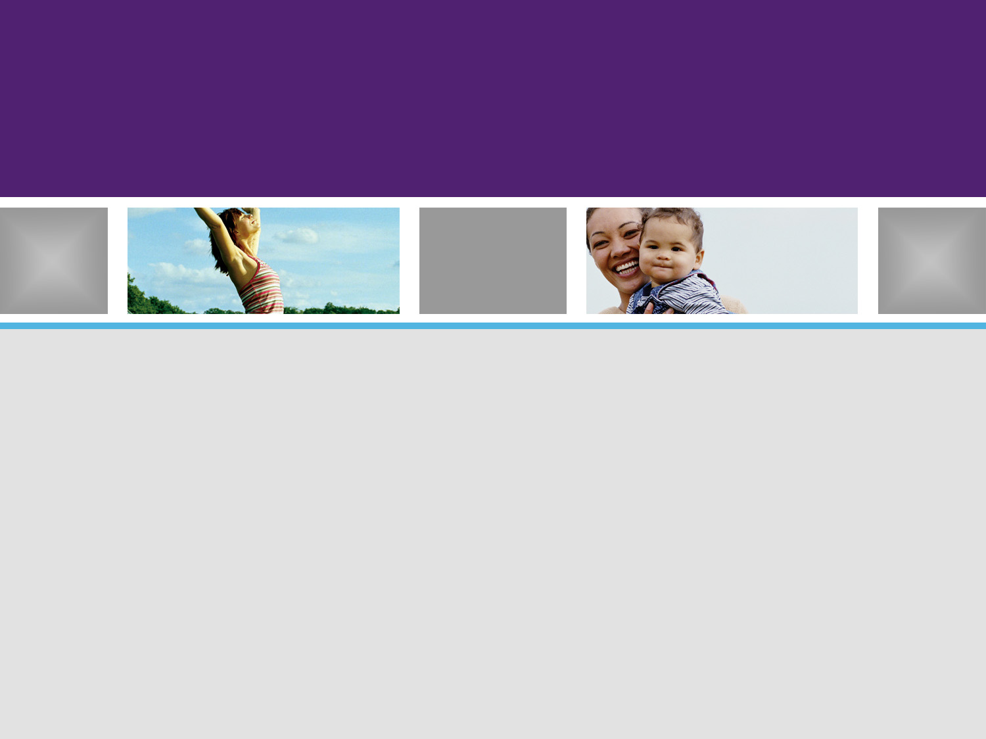
On Demand CRM
An innovative approach

Slide 2

What’s the goal of an On Demand Solution ?
The goal is to deliver a customer relationship management solution that is based on an extended service model that tightly integrates the disciplines across customer support, inside sales and the outside (external) sales teams.
We want to flip the traditional model for CRM over so that we implement a lightweight model that enables the outside sales & field sales staff while engaging the inside sales & support teams into a an On Demand support pyramid.

Slide 3

Contrasting the old with the new
Typical CRM implementations are heavyweight implementation to external staff & internal staff. The training is very disruptive, expensive and ROI on CRM initiatives never realized due to adoption issues.
Service-Based Model
Outside Sales
Field Support
Inside Sales
Support
Outside Sales
Field Support
Inside Sales
Support
Software-Based Model
The new approach is a lightweight approach where there are very few tools deployed to external staff. The internal staff (inside sales & support) use the CRM to provide on demand services to the external staff.

Slide 4
So, how does this new approach work ?
All of the tools surrounding CRM, BI, Support, Complaint Tracking, SLAs, etc. are all managed by the Inside Sales & Support (Help Desk) teams.
  Inside Sales will provide a similar set of services to the Outside Sales & Field Support staff that Support provides to customers. Their role will shift from reactive (task-oriented) to proactive (service-oriented).
  Support will continue to focus on customers but their tools will be augmented and integrated with the tools used by the Inside Sales team. They will also shift a portion of their role to proactive as they work collaboratively with Inside Sales.
The Outside Sales & Field Sales teams are abstracted from the tools and can focus on face-to-face with customers while being fed the right info from below.

Slide 5
How will this new approach impact staff ?
Think of this as the Mission Impossible model
Team | Process Overview
Outside Sales Field Sales | These are the front line folks who interface with customers not technology. They would be fed all the information they need from Inside Sales and Support to support them on customer visits, calls, deal optimization, loyalty optimization, managing customer expectations and capturing feedback and updates.
Inside Sales | This is a highly trained and energized group preparing dossiers for sales reps (in anticipation of customer visits), conducting research on new sales opportunities, capturing feedback from sales & field reps (post-mortems on visits/calls) and providing on demand support for sales & field reps who are at client sites.
Support | This team would provide Inside Sales with alerts, metrics, and analytics covering customer support, customer satisfaction and proactive information from data that is mined on a regular basis.

Slide 6
A few of the benefits…
Increased revenues
Increased customer loyalty & customer satisfaction
Improved use of key revenue generating staff
Reduced staff impact from technology changes
Improved morale
Enhanced growth (and revenue) opportunities
Extendable relationship model that can be used to manage all of our customers
Reduced risk from staff attrition
Improved metrics for measuring

Slide 7
Next Steps…
Review the approach with key outside sales staff
Identify additional stakeholders to review the idea
Socialize the idea amongst additional stakeholders
Obtain funding for an ’08 project to capture requirements, create a POC and build a business case for an innovative approach to delivering an On Demand RM Solution.

Slide 8
Appendix
Future vision for Relationship Management
Measure for success
Planning for cultural change

Slide 9
Vision for Relationship Management
The scope covers customers, suppliers, internal partners, and external partners.
The vision is to develop a 360 View of Customer Outcomes:
  Marketing (lead mgmt, marketing analytics)
  Sales (opportunity/deal mgmt, consulting, loyalty mgmt, order fulfillment and order accuracy)
  Contract Mgmt (contracts, pricing, SLAs)
  Support (Help desk, complaint mgmt, incident/problem mgmt.
  for starters…

Slide 10
Based on the vision, how do we measure success Customer Relationship Mgmt ?
We can start with measuring the basics:
  Customer Satisfaction
  SLAs
  Customer Loyalty
  Number of Customer Promoters
  Overall Revenues
  Margins
At the same time, we need to create new incentive plans that incorporate these metrics into everyone’s objectives (Moves Hospira from a product-centric model to a customer-centric model).

